Slide 1
Teradata Bacis
Lesson 06: Teradata Utilities Multiupload

Slide 2
Module Object
Introduction about Teradata Utility
About Multi load
Supporting Environment
Multi Load Tasks
Multi Load Tasks-IMPORT
Phases of Import Task
Example of Import Task
Multi Load Tasks-Delete
Example of Delete Task
DELETE Task Differences from IMPORT Task
Restarting Multiload
MultiLoad Commands

Slide 3
Introduction about Teradata Utility
What is the need of Teradata utilities in Data ware house
Quick access to data for more timely decision making.
Solutions for the entire spectrum of load requirements from batch to near real time.
Unmatched scalability for large volume loads.
Fail-proof loads with checkpoint restart capabilities.
Proven technology from the data warehouse technology leader.
Integration with industry-leading ETL and ELT tools.
Teradata Utilities
BTEQ: Help for Report formatting, Ad hoc query tool, Database administration, Best for small data volumes
Multi Load :High-performance data unload in client format. Fast Load: High-performance initial table load.
Multi Load: High-performance maintenance operations applies updates to multiple tables in single pass.
Apart from these teradata having other utilities like Teradata Parallel Transporter, Tpump e.t.c.

Slide 4
About Multi load
Multi load is a command driven parallel load utilities , used to load high volume of data to populated or empty
teradata tables and views. Teradata MultiLoad executes a series of MultiLoad commands and Teradata SQL statements written in a batch mode job script or interactively entered. The MultiLoad commands provide the session control and data handling specifications for the data transfer operations.
Features:--
Batch mode utility that runs on a server or host system. Supports up to five populated or empty tables.
Supports INSERTs, UPDATEs, DELETEs and UPSERTs; typically with batch inputs from a host file. Allows Duplicate rows.
Host and LAN support. Full Restart capability.
Error reporting via error tables.
Support for INMODs MULTILOAD HOST Teradata.

Slide 5
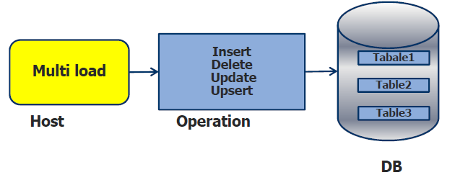
About Multi load
Features:--
Batch mode utility that runs on a server or host system. Supports up to five populated or empty tables.
Supports INSERTs, UPDATEs, DELETEs and UPSERTs; typically with batch inputs from a host file. Allows Duplicate rows.
Host and LAN support. Full Restart capability.
Error reporting via error tables.
Support for INMODs MULTILOAD HOST Teradata.

Slide 6
About Multi Load
Advantages:-
Minimizes the use of the PEs.
Gets input data to the AMPs as quickly as possible.
Uses multiple-AMP sessions.
Uses the parallelism of the AMPs to apply changes.
Keeps BYNET activity low with AMP-local processing.
Avoids Transient Journaling overhead.
Allows Checkpoint/Restartability even with down AMPs.
Prevents lengthy rollbacks of aborted jobs.
Allows for maximum access to table during processing.
Posts errors to special error tables.
Provides extensive processing statistics

Slide 7
Supporting Environment
The Multi Load utility is supported either on either the mainframe or on network attached system(LAN).
The LAN environment supports the following Operating Systems:
UNIX MP-RAS
•Windows 2000
•Windows 95
•Windows NT
•UNIX HP-UX
•AIX
•Solaris SPARC
•Solaris Intel

Slide 8
Supporting Environment
The Mainframe (Channel Attached) environment supports the following Operating Systems:
MVS
VM
CAUTION: The Teradata RDBMS will only support a maximum of 15 simultaneous Fast Load, Multi Load, or Fast Export utility job

Slide 9

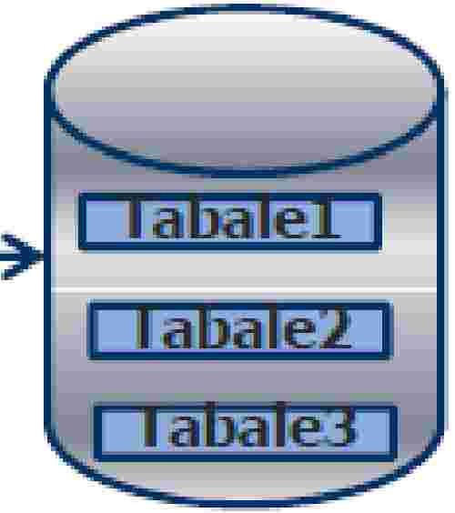







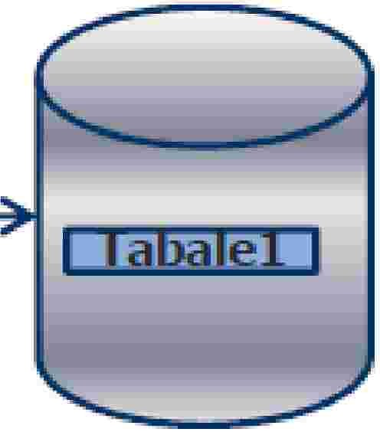
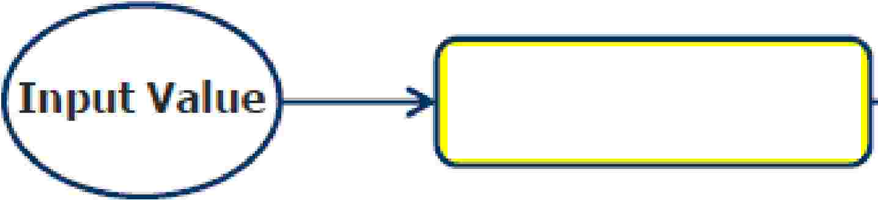




Multi Load Tasks
Basically Multiload use the source data and do the operation like Insert, Update, Delete and Up sert and keep in Teradata table.
There are two types of tasks that Multiload can perform.
1:
mport Taslk
Insert
Update
Input
Multi
load
Delete
u
Multi
loa�
Delete

Slide 10
Multi Load Tasks-IMPORT
INSERTs, DELETEs, UPDATEs and UPSERTs are allowed.
Up to a maximum of five tables:–Empty or populated.–NUSIs permitted.
MultiLoad Import task operations are always primary index operations -however, you are not allowed
to change the value of a table’s primary index.
Change the value of a column based on its current value.
Permits non-exclusive access to target tables from other users except during Application Phase.
Input error limits may be specified as a number or percentage.
Allows restart and checkpoint during each operating phase.
IMPORT tasks cannot be done on tables with USI’s, Referential Integrity, Join Indexes, Hash
Indexes, or Triggers.–IMPORT tasks can be done on tables defined with “Soft Referential Integrity”.

Slide 11
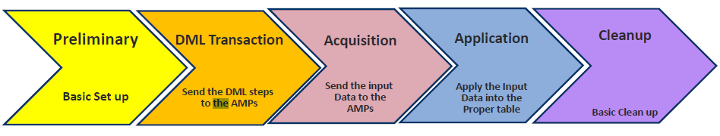
Phases of Import Tasks

Slide 12
Multiload: Preliminary Phase
Preliminary Phase:-
Validate the Multi load and SQL statements.
The first task is to be sure that the SQL syntax and Multi Load commands are valid. Multi Load ensures that it is much better to identify any syntax errors, right up front. All the preliminary steps are automated, so no user intervention is required in this phase.
Establish all Sessions.
Second, all Multi Load sessions with Teradata need to be established. The default is the number of available AMPs.

Slide 13
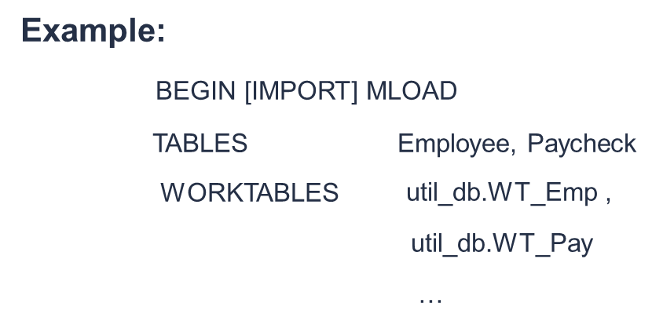
Multiload: Preliminary Phase
Preliminary Phase:-
Create Work Table Multiload create a work table for its support work. Work Table hold two things: the DML tasks requested and the input data that is ready to APPLY to the AMPs. Default is in user’s default database and the work table is named WT_TableName
Alternative may be specified as DataBaseName.WorkTableName
Create Error Table Multi Load requires two error tables per target table. The first error table contains constraint violations, while the second error table stores Unique Primary Index violations

Slide 14
Multiload: Preliminary Phase
Preliminary Phase:-
Error table 1 (ET)
Default is the user’s database and the table is named ET_Tablename.
Contains any errors that occur in the Acquisition Phase.
Contains primary index overflow errors that occur in the Application phase
Error table 2 (UV)
Default is the user’s database and the table is named UV_Tablename.
Contains Application Phase errors.
Uniqueness violations
Constraint errors
Overflow errors on columns other than primary index

Slide 15
Multiload: Preliminary Phase
Preliminary Phase:-
Example
BEGIN [IMPORT] MLOAD
TABLES Employee, PayCheck
WORKTABLES util_db.WT_Emp, util_db.WT_Pay
ERRORTABLES util_db.ET_Emp util_db.UV_Emp,
util_db.ET_Pay util_db.UV_Pay
. . . ;
Apply locks to target tables:
The final task of the Preliminary Phase is to apply utility locks to the target tables. Initially, access locks are placed on all target tables, allowing other users to read or write to the table for the time being. However, this lock does prevent the opportunity for a user to request an exclusive lock. Although, these locks will still allow the MultiLoad user to drop the table, no one else may DROP or ALTER a target table while it is locked for loading. This leads us to Phase 2.

Slide 16
Multiload: DML Transaction Phase
DML Transaction phase:-
All of the SQL Data Manipulation Language (DML)
statements are sent ahead to Teradata.
•Teradata's Parsing Engine (PE) parses the DML and generates a step-by-step plan to
•Execute the request. This execution plan is then communicated to each AMP and stored in the appropriate worktable for each target table.
Add a USING modifier to the request and host to be filled in from input file.

Slide 17


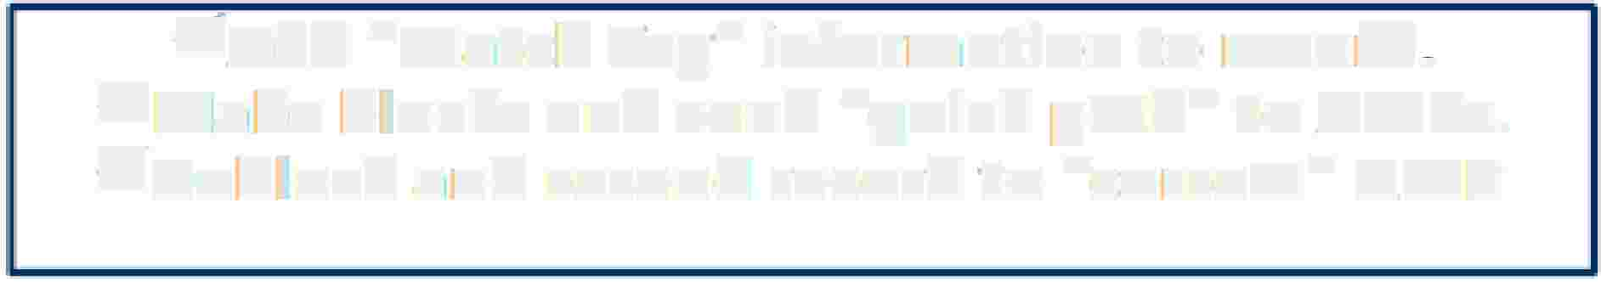



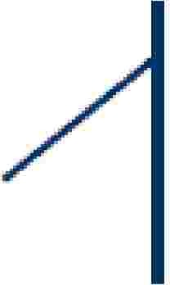


Multiload: Acquisition Phase
Acguisit'"on Phase:-
,/Add e.. Match T.ag" information to record, v"'Ma�e blocks and send "qulck path" to AMPs. v"Deblock and resend record to "correct" A.MP
¹G1et the data from host and apply it to approprlate AMP worktables ...
v'Sort 1:lhe rebl ocik,edl records in1 the, w,ork. ta biles. v'Sort by [hash valu:e and sequence to be· applied
Re block and store in worktable off target table
v'Upg1radle locks on targ:et tables to W1rite.
v'Se,i-table headers for AiPiPI i¹catio1n phase.
Set up transition to the Application phase
• The lllock applied during this phase is:
O
v"
,/
A.1cquisit:ion ock
DML. -allows all
DDL -allows DROP only
Note::
A. Errors that occur in this phase go into the Acquisition Error Table
B,,. There is no acquisition phase activity for a DELETE Task
(default name is ET_ta lename).

Slide 18
Multiload: Acquisition Phase
Application Phase:-
The purpose of this phase is to write, or APPLY, the specified changes to both the target tables and NUSI sub tables. To accomplish the substitution of data into SQL, when sending the data, the host has already attached some sequence information and five (5) match tags (describe in the next slide) to each data row. Those match tags are used to join the data with the proper SQL statement based on the SQL statement. In addition to associating each row with the correct DML statement, match tags also guarantee that no row will be updated more than once, even when a RESTART occurs.
Execute MLOAD for each target table as a single multi-statement request.
End of host interaction until end of phase.
AMPs independently apply changes to target tables.
Executed as a single transaction without rollback.
Restart able based on last checkpoint.
No transient journal needed.

Slide 19
Multiload: Acquisition Phase
The lock applied during this phase is:
Application lock
DML —allows SELECT with ACCESS only
DDL —allows DROP only
Note: Errors that occur in this phase go into the Application Error Table (default name is UV_tablename).

Slide 20
Multiload: Cleanup Phase
Cleanup Phase:-
If the last error code is zero (0), all of the job steps have ended successfully. If this being the case,all error tables made emptied, worktables and the log table are dropped. All locks, both Teradata and MultiLoad, are released. The statistics for the job are generated for output (SYSPRINT) and the system count variables are set. After this, each MultiLoad session is logged off. Below are the summary of the activities:

Slide 21
Multiload: Cleanup Phase
All locks are released.
Table headers are restored across all AMPs.
Dictionary cache of Target Tables is spoiled.
Statistics are reported.
Final Error Code is reported.
Target tables are made available to other users.
Work Tables are dropped.
Empty Error Tables are dropped.
Log Table is dropped (if Error Code = 0).

Slide 22









Example of Import Task
.LOGTAIBlElogtablleOO'l_,mlld;
• LOGrONtd p3/ useir:2,,tyl er;
.BEGIIN MLOAD lABLESE m1plo,yee, Emplloyee_Histo1ry
TEINACITY2
SLEEP 10;
Begin Loading
How many hours ( 2 ) to try
Establishing session when initial
Effort to do so is rebuffed
.lAYOUTRe1co1rd_lay1out:; ,
.FILLIER i'n_lransoodel CHAR(3.);
.FIELD, iin_Eim1P,INl10* SMALLINT;
.FIELD in_DeptNo* SMALLINIT;
.FIELD in_Salary * DECIMAL {8�2,);
Tells multi load how frequently
in minute (10) to try login into the stem
.DMIL lABEL Payr,oll DO IINSERT FOR IMISSIING UPDATE ROWS;
Definition of input layout
UPDATE Employee SET Salary·= :iin_Sala1ry
WHIERE Em1pNo= ::inJEm1pNo;
Definition of an UPSERT.
INSEIRTIN1TOEm1ployee (IEm1pNo, S,al,a1ry)
VALUES(::iin_Em1PH0, :in....:,Sallary);
.DMIL lABEL Terminate j:
DElETEFIROM !Employee WHERE IEmpNlo= ::in_,EmpN¹o;: INSERT INTO Emplloyee_Histo1ry (IEm1pNlo,. De1n,,';lll!A...--�
VAlJU ES. {:: in_Eim1p,No, : il!Jm1-.lJalptf;�-
lfi le name to ·mport from
.IMPOIRT IINFlllE iirnfiilel
End
loading.
LAYOUlRecord�_;L;y;o�u;t!,.l[il.ll1SJ:o1Mle'9:!'tl'!:-::::�------------------�--------71
APP LY Payro II �HIE RE in I
APPLY Termin e : ERIE in_Tra1nscode= ¹DEL¹
;
.ENID MLOAD;
.LO GOFF;

Slide 23
Multi Load Delete Task
Not part of Multiload Import, which consider the sql “Delete” statement.
Not follow the Transient Journal like Import delete.
No Rollback applies, when job failed.
Follow the Restartibilty and check points
Not consider the primary index.

Slide 24
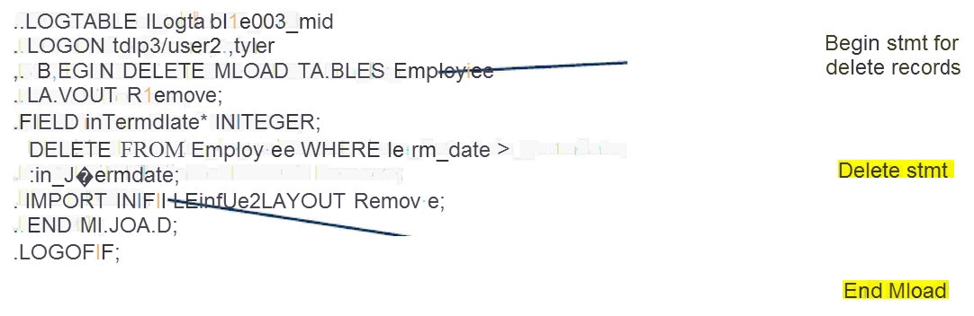
Example of Delete Task

Slide 25
DELETE Task Differences from IMPORT Task
DELETE tasks operate very similarly to IMPORT tasks with some differences:
Deleting based on a equality UPI Value is not permitted.
A DML DELETE statement is send to each AMP with match tag parcel.
No Acquisition phase.
Application Phase reads all target blocks and deletes qualifying rows.
Multiload Delete vs SQL Delete.
Multi load Delete is Faster as compared to SQL Delete.
Multi load Delete is restartable.

Slide 26
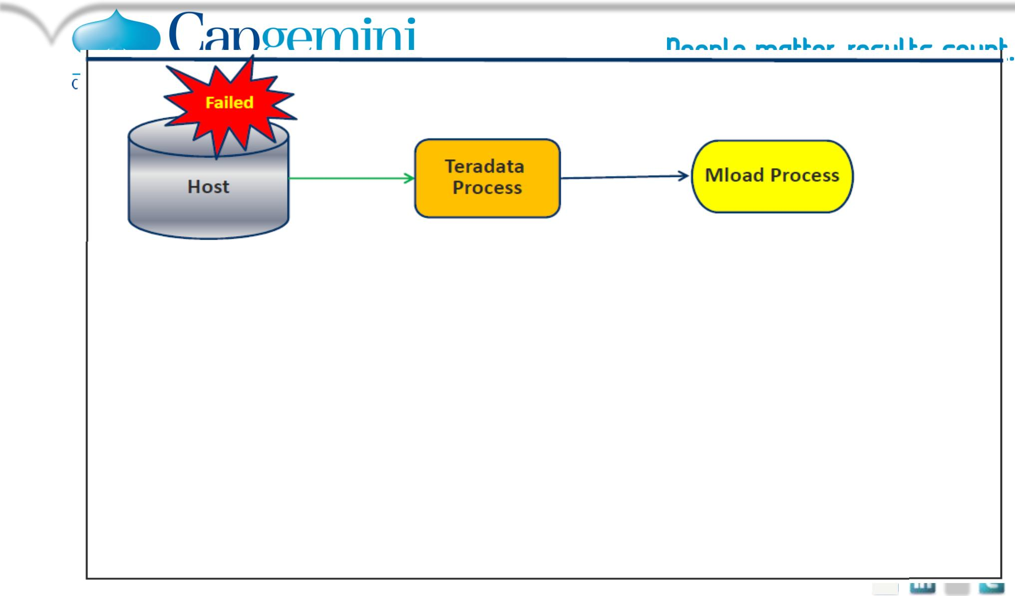




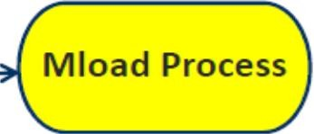


Teradata
Process
Resubmit the original script.
MLOAD determines its stopping point and restarts.
Teradata
Process
Host
MLOAD reinitiated automatically after Teradata recovery.
Continue from checkpoint without user interaction.
Copyright © 2015 Capgemini. All rights reserved. Rightshore® is a trademark belonging to Capgemini.

Slide 27
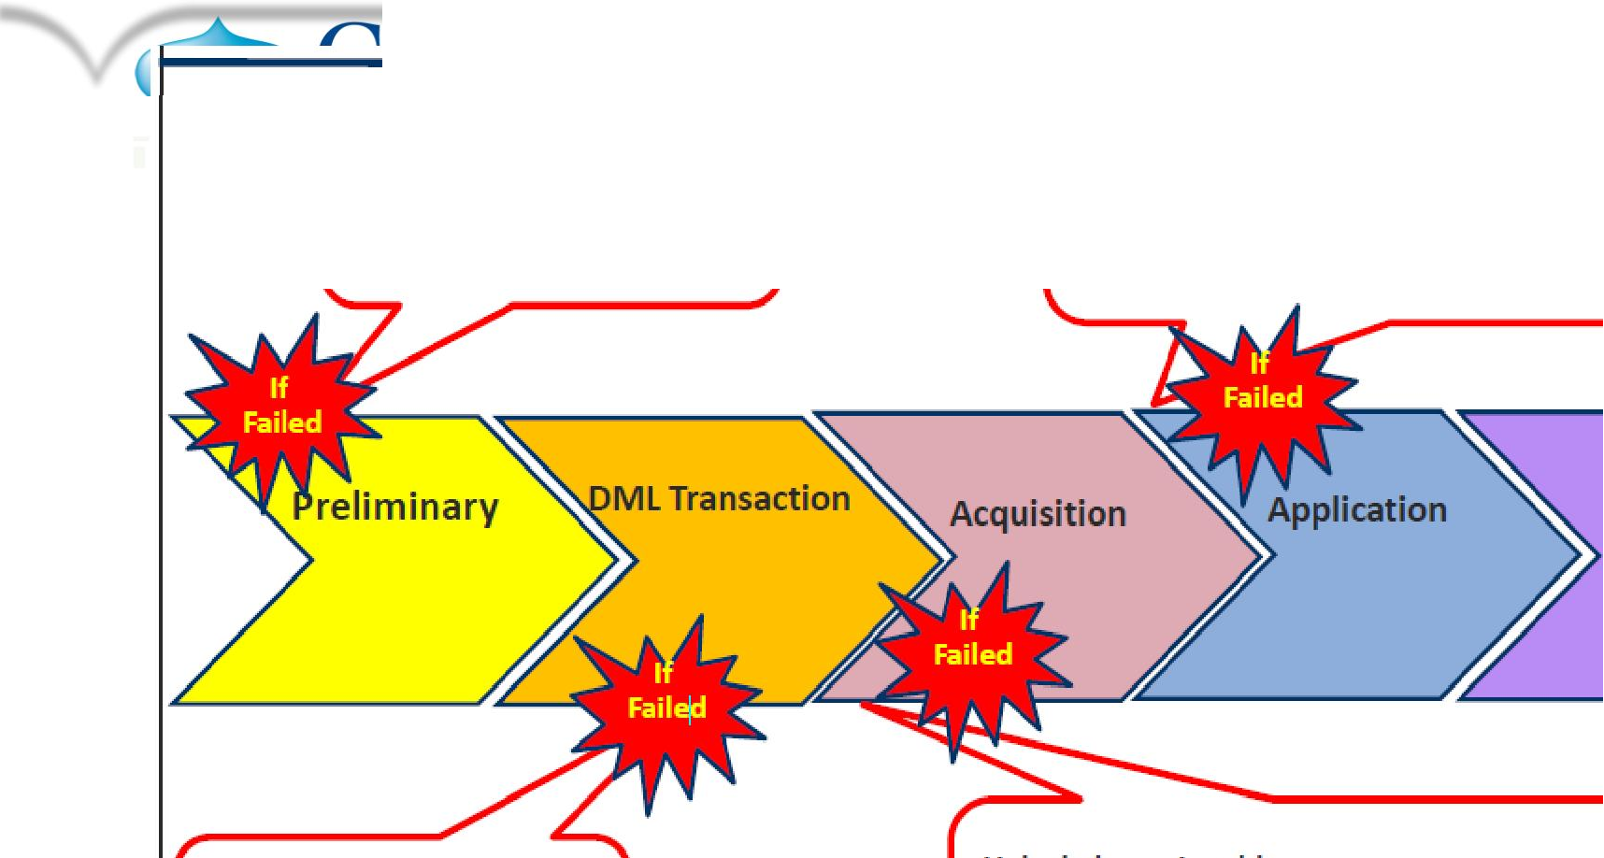
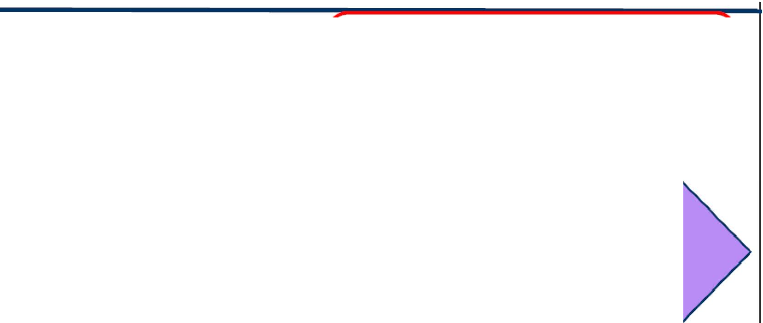






Restarting Multiload
•
⁻c simply resubmitting the job again and
Correct the script and
Rerun again.
it will be fine and start from the checkpoint.
OR
drop the two error ta,bles one work table one log table and release mload from the target table.
Cleanup
Correct the script and
Rerun again.
Unlock the main table,
by using the command.
RELEASE MLOAD <DATABASENAME.TABLE NAME>;
The information contained in this presentation is proprietary.

Slide 28
MULTILOAD COMMAND
.BEGIN
MLOAD
=IMPORT]
.BEGIN
This command communicates directmy with Te!J"'adata to specify if the
MulbiLo.ad mode is going to be IMPORT or DELETE. Note that the W'ord
DE1LETE MLOAD
£MPORT is. opt:ional iin ilthe synl:ax because it. iis. ·the DIE FAULT"
DELETE is required. !Ve recomrnend usin9 Ehe. word IMPORT to
coding consistent and easier for others t:o read. Any parameters
but
make tine
for the
load, such as error limits or checkpoints will be included under the . BEGIN
c crnrnerrd, too. It is importa111t ro know which commands or parameters are
optional since, if you do not include them, Mult1iLoad may supply defaults
that may impact your load.
The DML IL.ABEL defines treatment options and labels for the application
{APPLY) of data for tihe INSERT, UPDATE, UPSERT and DELETE op ere tioris ..A LABEIL is simply a name for a requested SQL activity. The LABEL is defined first, and th12n referencsd later �n the APPLY clause.
This •..-..et...-, • .-lt-'e Mu!!!:iLoad to f!:n!sh the l\PDLY cper-.a tiorrs ·�.dth the ch.ariges to
t1,1e desiqnated databases and tables.
This defines a column of the· data sourrce record that will be sent to the
Teradata database via SQL. \.i\llhen writing the script� yo._1 must rnciude a
FIELD for each data field you need in SQL. This c ornrriarrd is used with the
L...�,YOUT command.
Do not assume that MultrLoad ha1s somehow uncovered rrurcb of vfi·hat y,o._,
.DML LABEL
.FIELD
.FILLER
used in your terr1n papell"S at the university!
FILLER defines a field that is
row format,, but: is not: sent to
accounted for as part of the
data
with
source's
tlle
Teradata DBS. It is used
the LAYOUT comrnarid:
lNPUT DATA record so Teradata kno rr1s
.LAYOUT
LAYOUT defiines the format of the
what to expect. If one record 1s not: large enough,, you
can concat:,enate
multiple by using the LAYOUT parameter CONTINUEIF t:o tell which value to
perform for the conc.atenation. Another option is INDICATORS, ri1hich is
used to represent: nulls by using the bitn,ap ( 1 bit per field) at. the front of
tlle data record.

Slide 29
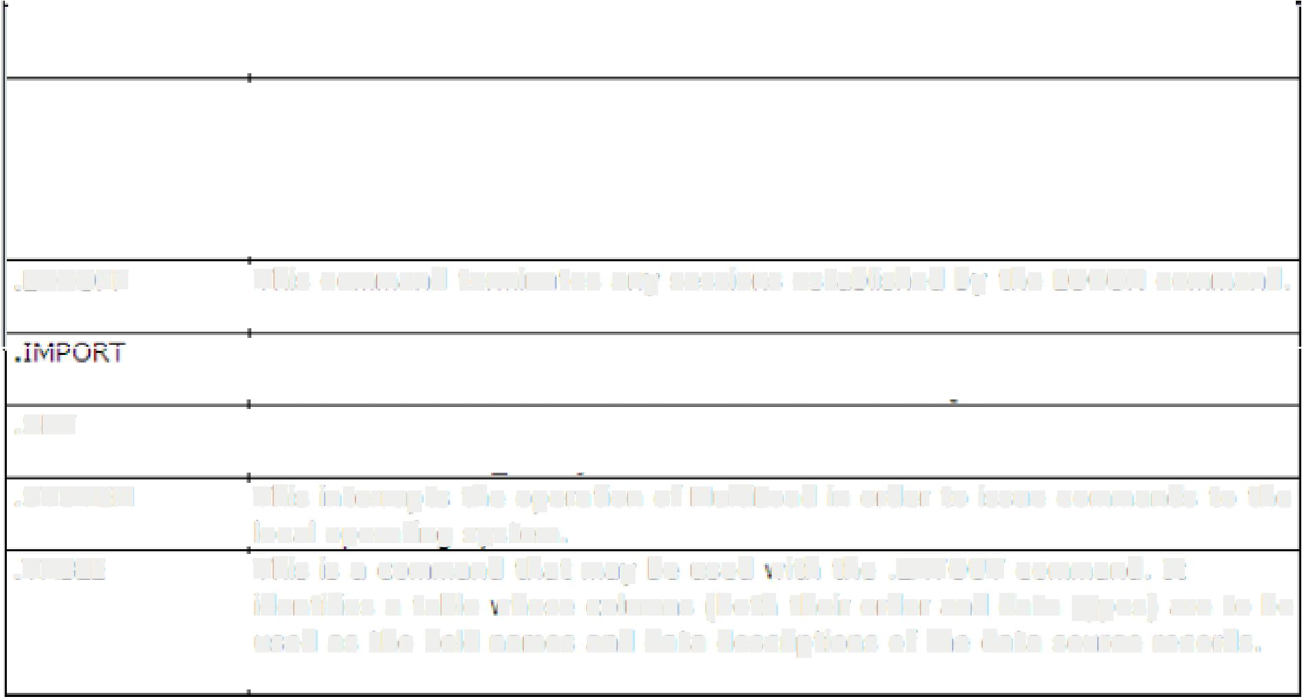



MULTILOAD COMMAND
• •
••
.LOG ON
This specifies the username
Multiload with Teradata.
or LOGON string that � ill establish sessions for
�LOGTABLE
This support command names the name of the Restart Log that will be used
for stoning CHECKPOINT data pertaining to a load. The LOGT BLE is then
used to tell Multiload ri.there to RESTART1 should that be necessary. n is
recommended that this command be placed betor«
the .LOGON commend.
• LOGO FF
This corumand
-·.
terminates any sesslons
es.ta,blished
by the
lOGON command .
I
I ,-
.-.
ueunes uie 11�1-'U I U,l!,lLi I A
i1L...t:, rue I.Yl,J!.':₁ 1111;'
IU;i';d�t:₁ uie
I rll;i, �UUll!ldllU
' I
LAYOUT to use and �11here to APPLY the data to SQL.
Optionally, you can SET utility variables. An example would be {.SET
DBName TO �CD.ILLTest�}.
This interrupts the operation of Multil.cad in order to issue commands to the
local operating system.
This is a command that may be used vith the .LAYOUT command. It
.. SET
.SYS,TEM
.TABLE
identifies a table vhese columns roott, their order and data
types) are to be
used as the field names and data descriptions of the data source records.

Slide 30
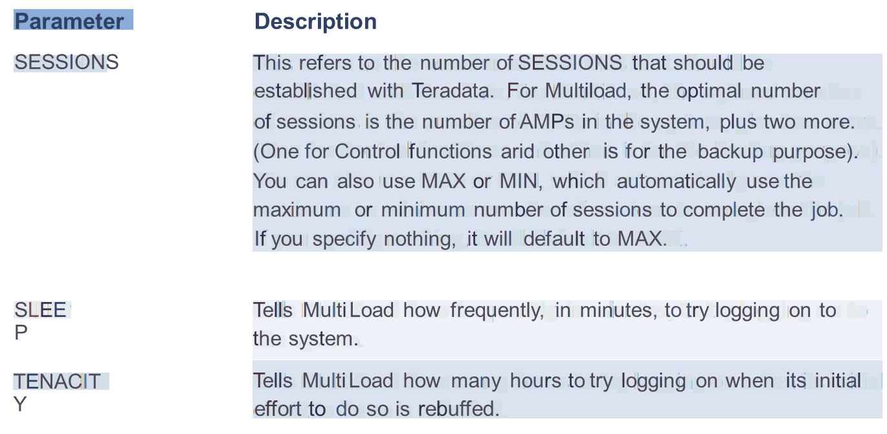
MULTILOAD Parameters

Slide 31
Limitation of MultiLoad
Though MultiLoad is a very powerful utility; it has following limitations:
1. MultiLoad Utility doesn’t support SELECT statement.
2. Concatenation of multiple input data files is not allowed.
3. MultiLoad doesn’t support Arithmetic Functions i.e. ABS, LOG etc. in Mload Script.
4. MultiLoad doesn’t support Exponentiation and Aggregator Operators i.e. AVG, SUM
etc. in Mload Script.
MultiLoad doesn’t support USIs (Unique Secondary Indexes), Referential Integrity,
Join Indexes, Hash Indexes and Triggers.
Import task require use of PI (Primary Index).

Slide 32
MultiLoad Review Questions
Answer True or False.
1. With MultiLoad, you can import data from the host into populated tables.
2. MultiLoad cannot process tables with USIs or Referential Integrity defined.
3. MultiLoad allows changes to the value of a table’s primary index.
4. MultiLoad allows you to change the value of a column based on its current value.
5. MultiLoad permits non-exclusive access to target tables from other users except during Application Phase

Slide 33
MultiLoad Review Questions
Match the MultiLoad Phase in the first column to its corresponding task in the second column.
1.______Preliminary | A. Acquires or creates Restart Log Table.
2.______DML Transaction | B. Locks are released.
3.______Acquisition | C. Applies (loads) data to the work tables.
4.______Application | D. Execute mload for each target table as a single multi-statement request.
5.______Cleanup | Stores DML steps in work tables.

Slide 34
Answers of MultiLoad Review Questions
Match the MultiLoad Phase in the first column to its corresponding task in the second column.
1.___A___Preliminary | A. Acquires or creates Restart Log Table.
2.___E____DML Transaction | B. Locks are released.
3.___C___Acquisition | C. Applies (loads) data to the work tables.
4.___D___Application | D. Execute mload for each target table as a single multi-statement request.
5.___B___Cleanup | Stores DML steps in work tables.

Slide 35
ANSWERS OF MULTILOAD REVIEW QUESTION
With MultiLoad, you can import data from the host into populated tables.
True
MultiLoad cannot process tables with USIs or Referential Integrity defined.
True
MultiLoad allows changes to the value of a table’s primary index
Flase
MultiLoad allows you to change the value of a column based on its current
value.
True
MultiLoad permits non-exclusive access to target tables from other users
except during Application Phase.
True

Slide 36
MultiLoad LAB Exercise
Purpose:
In this lab, you will use MultiLoad utility to insert the data rows in OLAP_EXAMPLE table. We use the Linux/Unix environment to execute the script.
What you need:
The required table and data file.
Tasks:
1.Prepare a MultiLoad script which inserts rows into the table using the redefinition feature of MultiLoad.

Slide 37
MultiLoad LAB Exercise
Tasks:
1.Prepare a MultiLoad script which inserts rows into the table using the redefinition feature of MultiLoad.
2. Ensure that the table has been created in the database properly.
3. Run the script.
Note: The Trans_Date is exported with an ANSI Date Format of 'YYYY-MM-DD' and a data type of CHAR(10).

